Slide 1

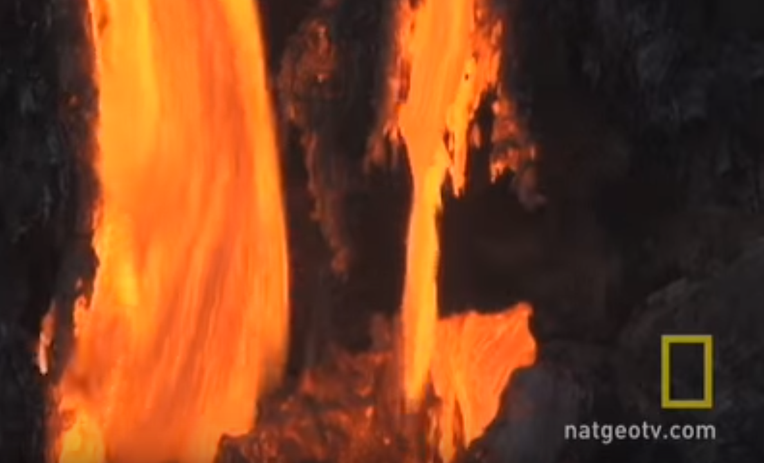

?
?
Notes:
Let students watch National Geographic video on Volcano Lava (1min 11secs) either by clicking on picture or going to https://www.youtube.com/watch?v=xExdEXOaA9A
Ask them some exploratory questions without giving them any answers e.g.
What was happening in the video?
What was all of that red stuff?
Was is solid or liquid?
What temperature do you think it might have been?
Where was it coming from?
What will happen to the red material?
Why do you think it was red/orangey in colour?
Why do you think it sometimes exploded and sometimes flowed along the ground?

Slide 2


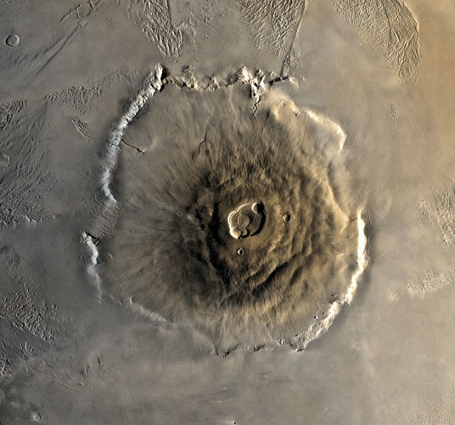
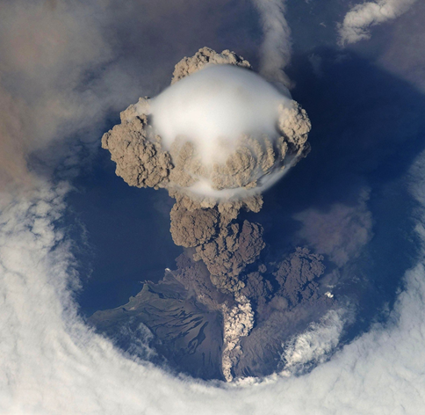
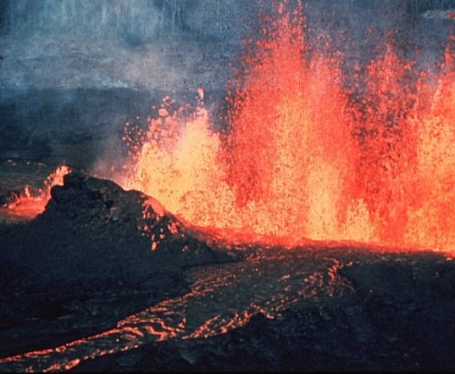
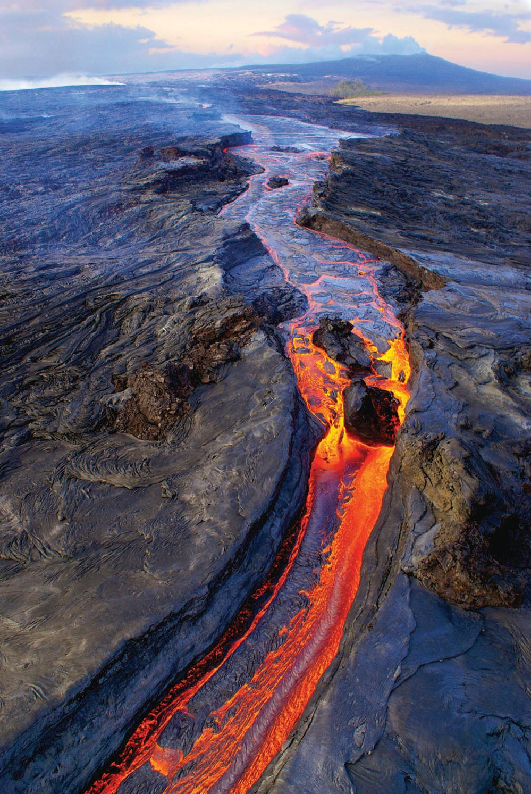
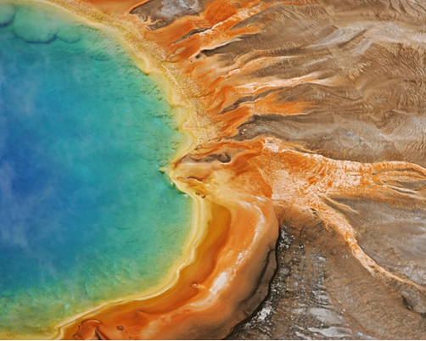
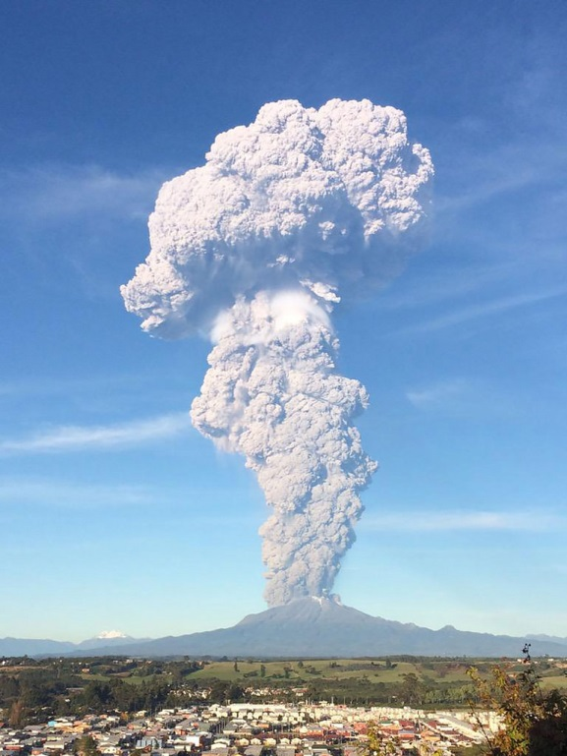
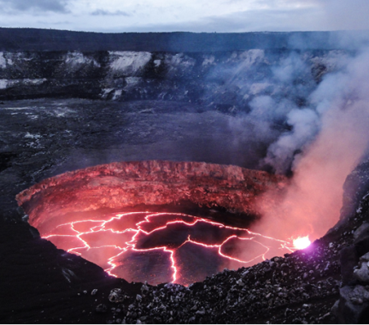
VOLCANOES
Notes:
We are going to be learning about volcanoes. Open question: What is a volcano?

Slide 3

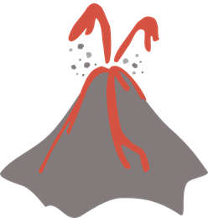
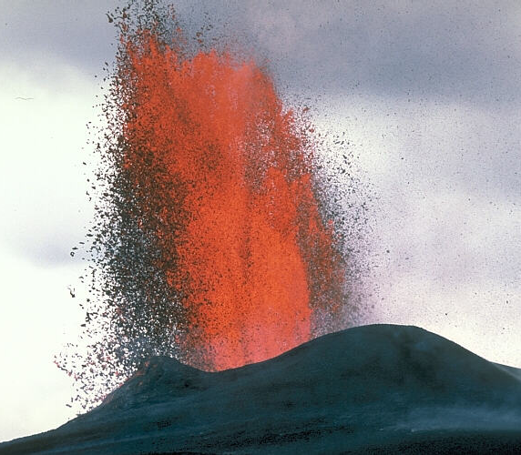
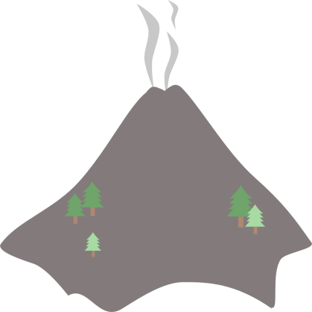
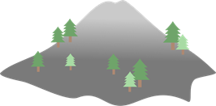
Hot rock
Active
Dormant
Extinct
z
z
z
Cool rock
Notes:
Volcanoes are openings in the Earth’s rocky surface which allow hot molten (melted) rock, ash and gas to escape from below the surface a bit like a chimney.
Q: What do geologist call this red hot rock that can sometimes erupt from a volcano? A: Lava
Q: how hot do you think lava can be? A: Lava can get to temperatures above 1100°C – water boils at only 100°C so you do not want to get too close to hot lava!
Volcanoes are not always erupting – they can be active, dormant or extinct
Active volcanoes are volcanoes that are either currently erupting or known to have erupted recently (geologists work on very long timescales so ‘recently’ means within the last 10,000 years!)
Dormant volcanoes are volcanoes that are ‘asleep’ – they are still thought to be active and could erupt again but they haven’t done so in the last 10,000 years
Extinct volcanoes are volcanoes that will never erupt again because their supply of magma has run out and turned into solid rock.
The UK has many extinct volcanoes including Helvellyn in the Lake District, Arthurs Seat in Edinburgh, Ben Nevis in Fort William and Snowdon in north Wales

Slide 4

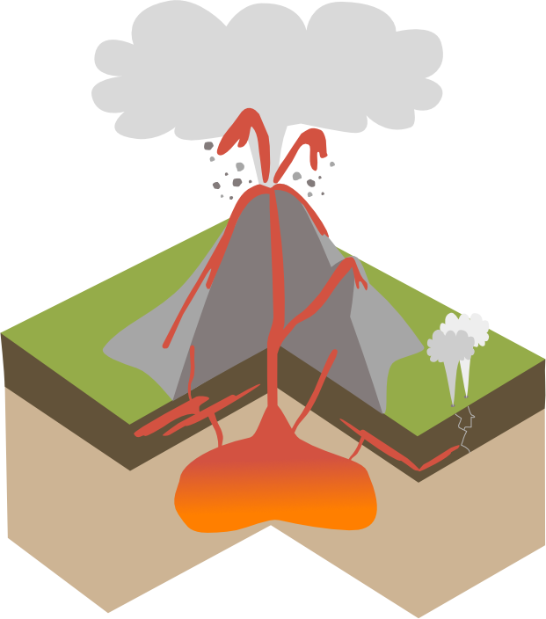
Ash, steam & gas
Lava
Magma chamber
Crater
Geysers
Secondary vent
Sills
Volcanic bombs
Conduit
Main vent
Notes:
Volcanoes are not just holes in the surface of the Earth, if we slice into a volcano we can what happens underground.
Deep underground beneath the volcano, magma (which is what geologists call lava that hasn’t erupted yet) collects in large pools known as magma chambers. As more and more magma is added to the magma chamber, the pressure increases and causes the rock around the magma chamber to crack.
The hot liquid magma, which is lighter than the surrounding rock, rises upwards through conduits or cracks in the crust and erupts on land through a volcanic vent.
Magma that reaches the Earth’s surface erupts as lava. Ash, gas and steam can also erupt from the volcano. Sometimes when a volcano erupts it can blow the top off the volcano creating a bowl shaped crater.
As the volcano erupts over days, weeks and even thousands of years, each eruption of lava and ash adds layers onto the volcano so that over time it grows into a huge landform.
Have students guess some of the labels that link to the diagram
Ash steam and gas – material erupted from a volcano
Lava - erupted magma
Magma chamber - pool of magma below the volcano
Crater - created when an eruption blows the top off a volcano
Geysers - vent that shoots steam and boiling water into the air
Sills - flat sheets of igneous rock formed underground rather than erupting from a volcano
Volcanic bombs - lumps of rock and blobs of lava ejected by the volcano,
Conduit - channel which magma travels through
Main vent - main opening in the ground surface

Slide 5
Ash, steam & gas
Volcanic bombs
Crater
Main vent
Secondary vent
Conduit
Lava
Geysers
Sills
Volcanic bombs: large lumps of rock and molten blobs of magma thrown out from the volcano
Ash, steam & gas: material erupted from the volcano
Geyser: vent that shoots steam and boiling water into the air
Sill: flat sheet of igneous rock formed underground
Magma chamber

Slide 6

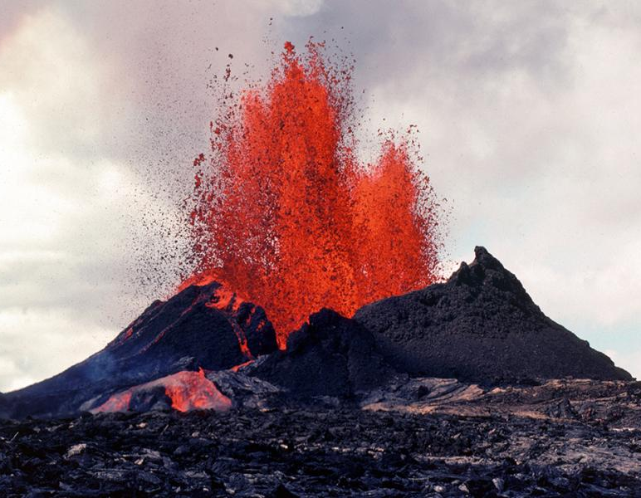
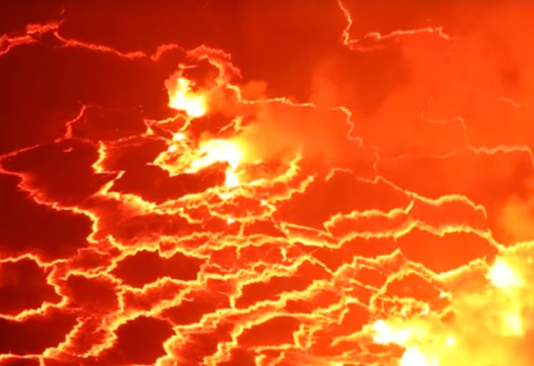
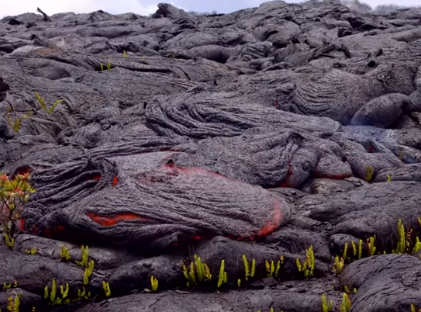

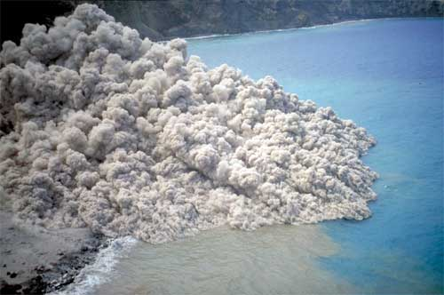
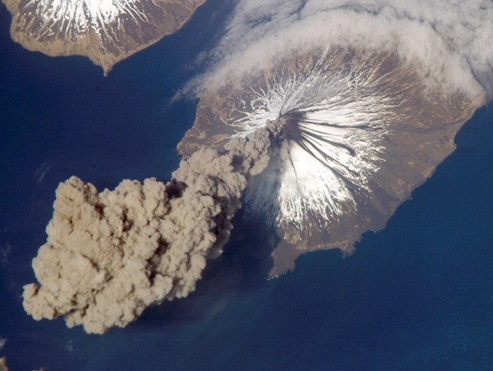
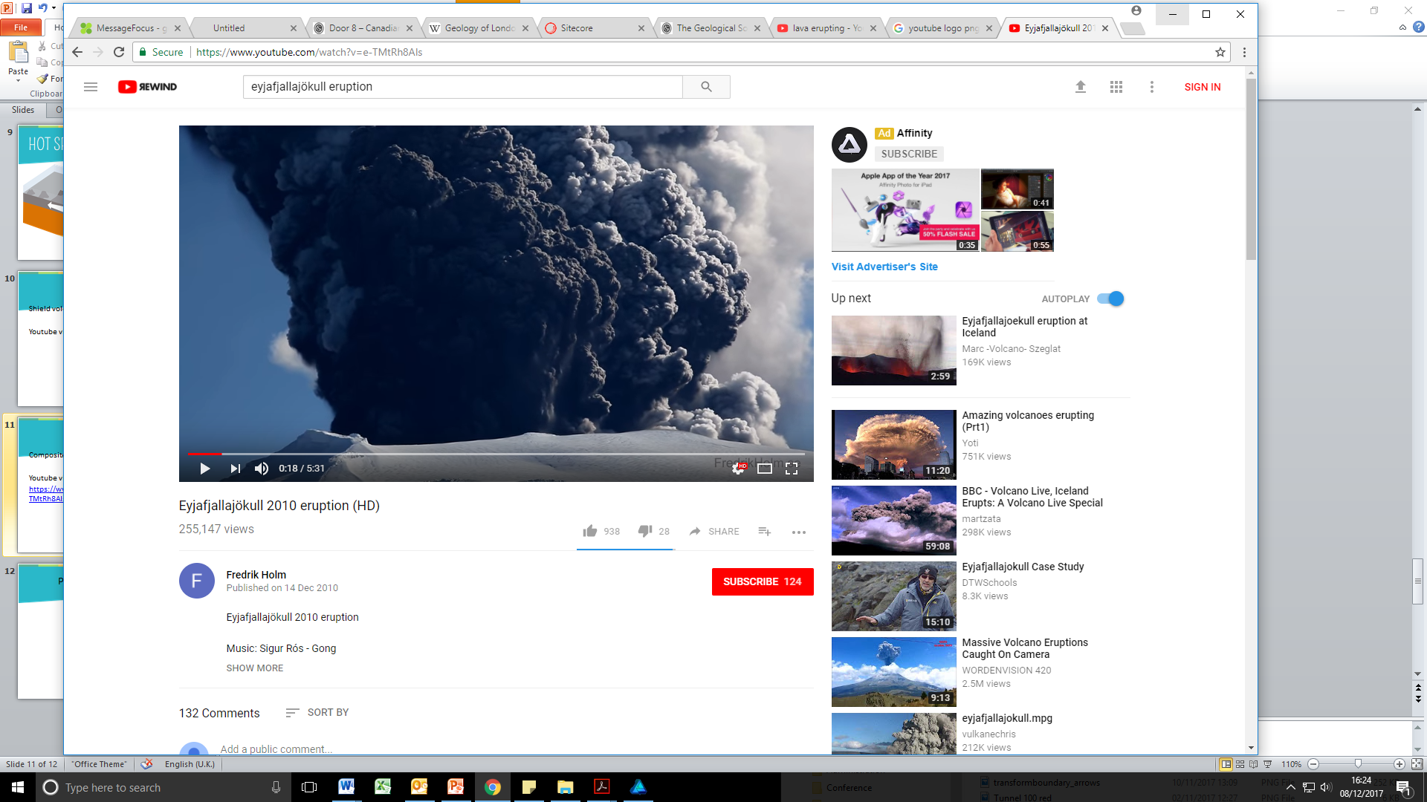
Lava lake, Nyiragongo
Volcanic bomb
Effusive
Lava fountain, Hawaii
Pyroclastic flow, Monserrat
(British Geological Survey)
Explosive
Ash cloud, Aleutian Islands
Notes:
There are two types of eruption that can happen from a volcano called effusive and explosive. The type of eruption effects what will be erupted.
If the magma is runny and doesn’t have many gas bubbles, then the volcano will erupt gently, what geologists call effusively, lava can spray up as a fountain or flow gently from the volcano as a lava flow
If the magma in the magma chamber is sticky and has lots of gas bubbles trapped within it, then the volcano will erupt violently making a big cloud of ash and gas above the vent.
Q: What happens when you shake a fizzy drink? A: It explodes!
Fizzy drinks contain carbon dioxide gas under pressure and this is what makes the fizzy. When a bottle of fizzy drink is shaken, lots of extra bubbles of carbon dioxide gas are created. These extra bubbles want to get out of the bottle so when you unscrew the cap, the bubbles explode out of the bottle taking the fizzy drink with it. This is what happens in explosive eruptions – the bubbles of gas trapped within the magma explode out of the volcano taking rock fragments, lava and ash with it.
Watch the two videos – lava from Kilauea (‘Kil-ah-way-ah’) volcano in Hawaii showing an effusive eruption and ash clouds from Eyjafjallajokull (‘ey-yah-fyel-lah-yo-kul’) in Iceland showing an explosive eruption.
Recommended to the Hawaii video from start for about 1 minute and start Iceland video at 1:30 and watch for around 1 minute (see if you can spot the volcanic bombs and rock fragments!).
Sometimes the gas and ash column generated during an explosive volcanic eruption collapses and creates a flow of hot gas and ash that races down the side of a volcano – this is known as a pyroclastic flow. Pyroclastic flows can be over 800°C and travel extremely quickly at over 10m per second!
Effusive eruptions can also sometimes form lava lakes, these are lakes of molten lava contained in the crater of volcano and are very rare on Earth - watch 50 second YouTube video of Nyiragongo lava lake by clicking on picture or going to https://www.youtube.com/watch?v=_2th8dY03Wo

Slide 7

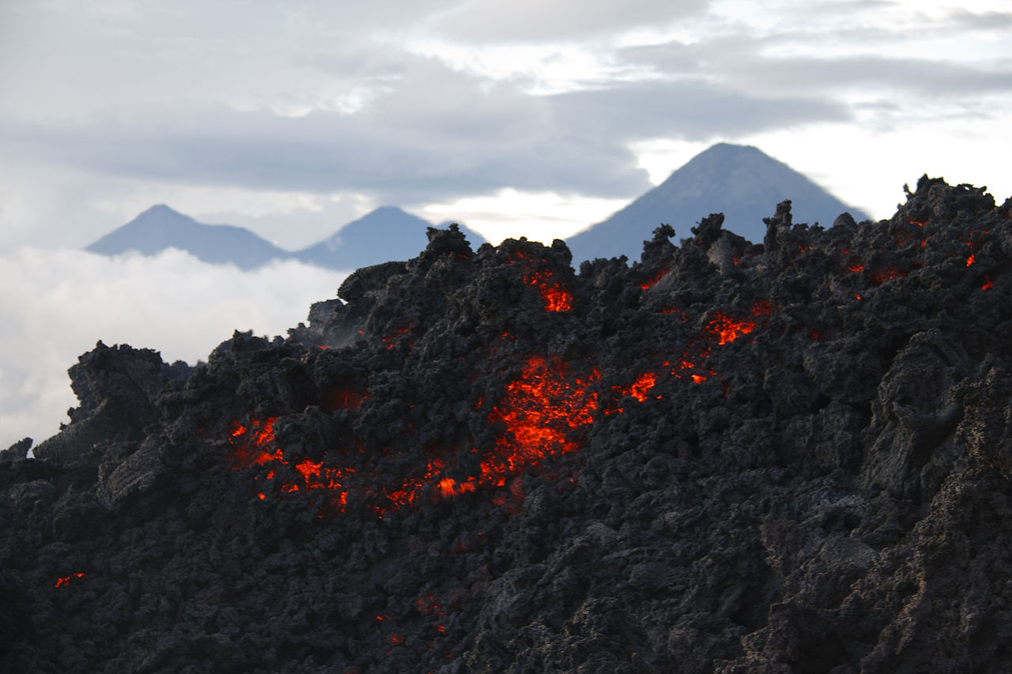
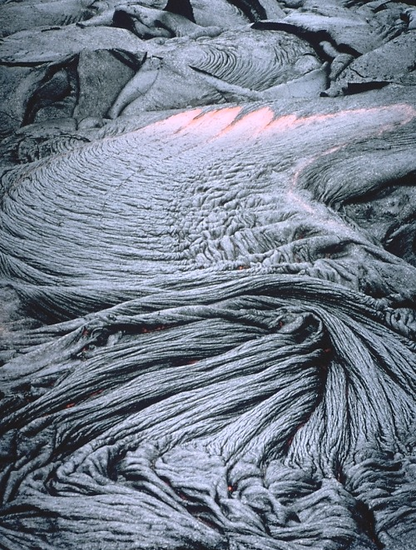
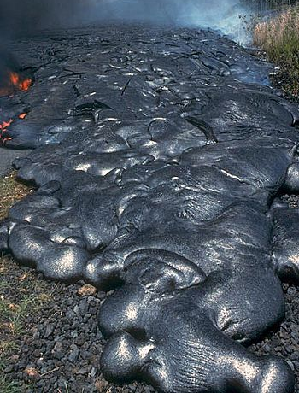
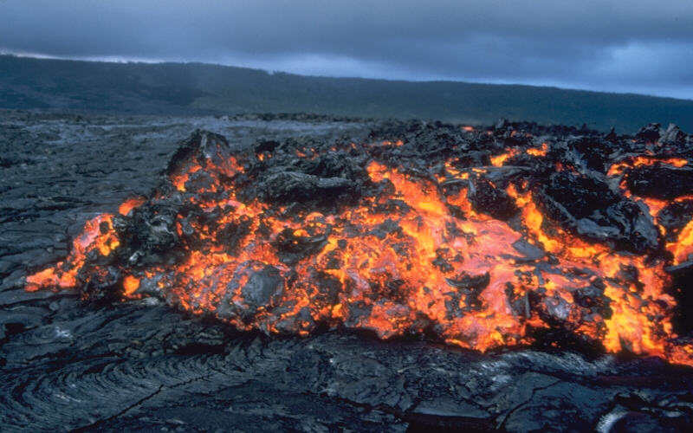
´A´a lava, Guatemala
Photo: Librex/CC-By-2.0
´A´a lava, Hawaii
Pahoehoe lava, Hawaii
Pahoehoe lava, Hawaii
Notes:
There are two main types of lava that come out of a volcano during an effusive eruption, Pahoehoe pronounced ‘pah-hoey-hoey’ and ´A´a pronounced ‘ah-ah’.
Pahoehoe and ʻaʻa are both Hawaiian words that are used by geologists to describe these kinds of lavas.
Pahoehoe forms from slowly flowing lava and has a smooth or ropey surface when it hardens into rock.
’A’a forms from fast flowing lava and has a rough, rubbly surface with jagged blocks when it hardens into rock.

Slide 8

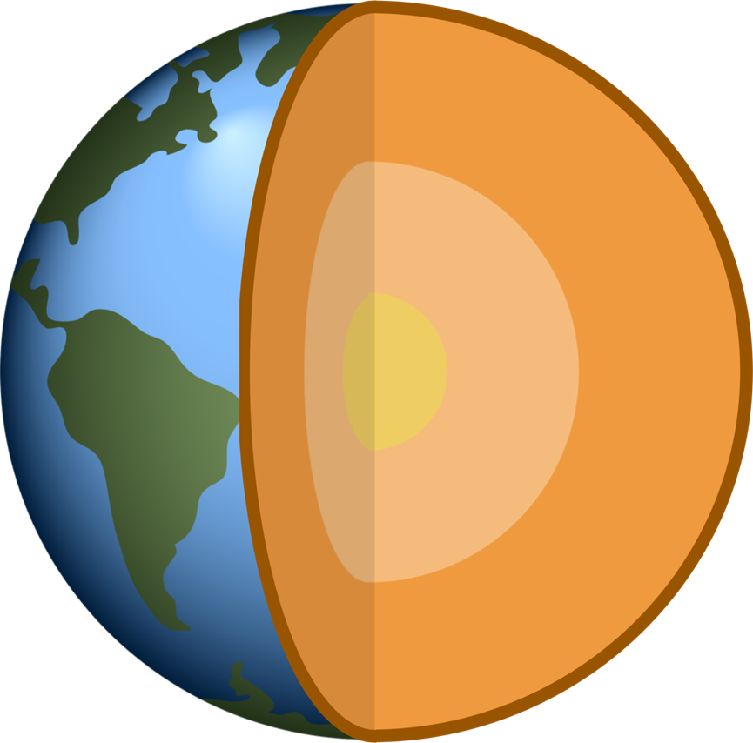
Crust
Mantle
Outer core
Inner core
Notes:
Now we know what volcanoes are, and what can be erupted from a volcano, but where and why do we get volcanoes on Earth? For this we need to know a little bit about the structure of the Earth.
If students have already studied the layers of the Earth, get them to recall the names and compositions (rock/metal, solid/liquid) for the different layers. If this is the students’ first time learning about the Earth’s structure have them guess the names of the layers and tell them what they are made from:
Inner core – solid metal (nickel and iron) Temperatures between 5000- 6000°C, this is as hot as the surface of the Sun! These temperatures on land would be easily hot enough to melt metal but due to the immense pressure of the other layers squashing down on it, the inner core is completely solid.
Outer core – liquid metal (nickel and iron) similar temperatures to the inner core. The outer core can flow and is what causes the Earth to have a magnetic field.
Mantle – Solid rock, 2900km thick, under certain conditions parts of mantle can melt to form pockets of liquid rock called magma however it is primarily solid
Crust – solid rock - all of the Earth’s oceans, rivers, mountains, volcanoes, hills and valleys are part of the crust.
Q: what are the big landmasses called that make up the crust? A: Continents
The Earth’s crust is made up of heavy oceanic crust, which forms the ocean basins, and lighter continental crust which forms the landmasses.

Slide 9

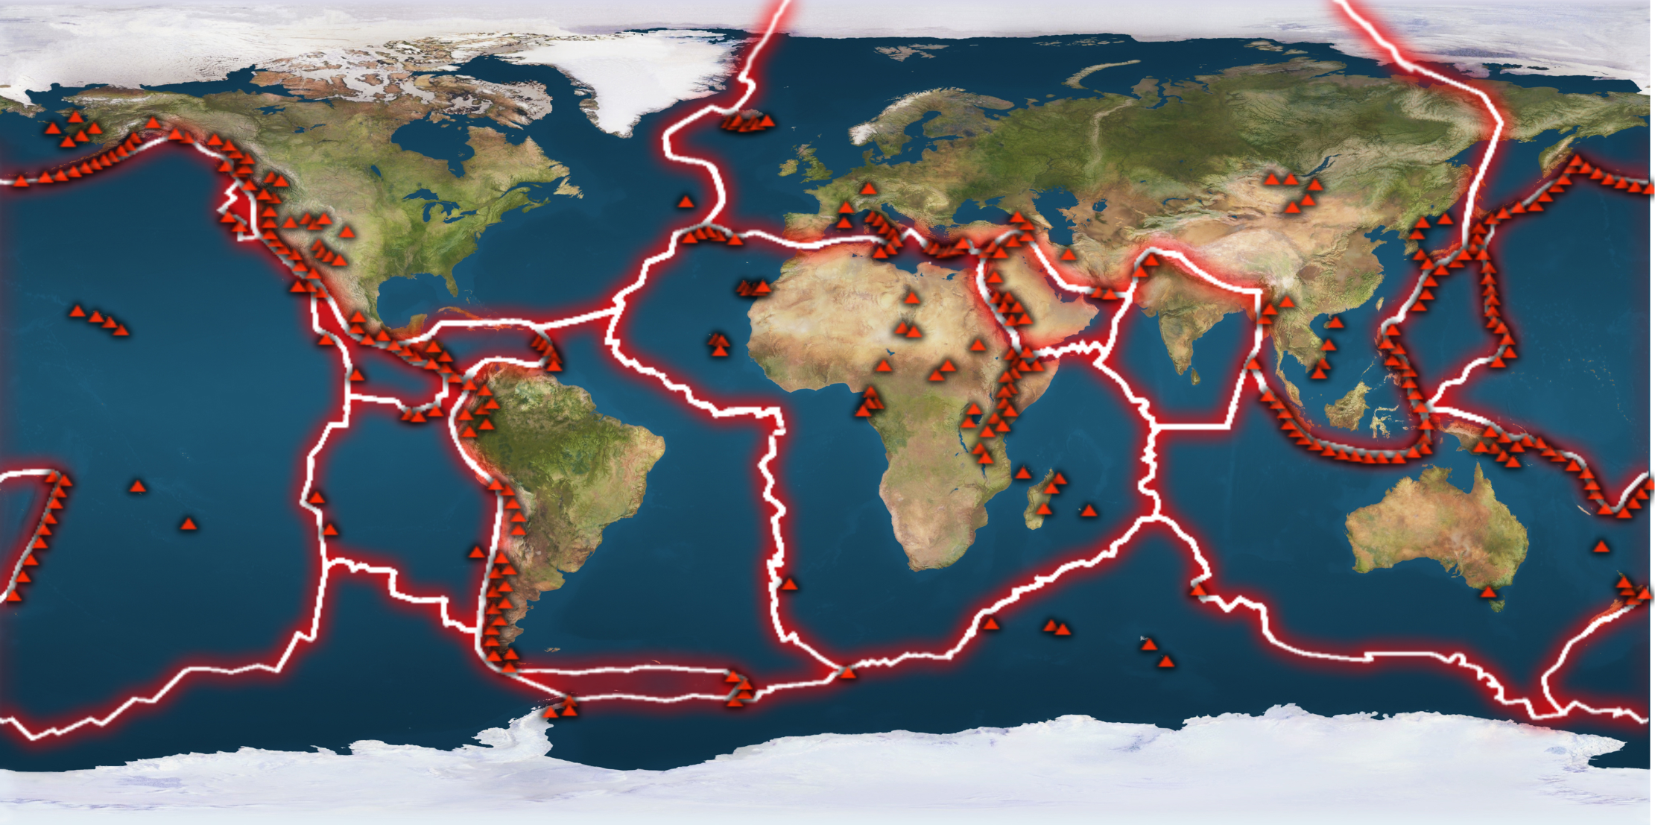
Eurasian plate
Caribbean plate
Nazca plate
Antarctic plate
Indian plate
North American plate
South American plate
Australian plate
Arabian plate
Pacific plate
African plate
Notes:
The Earth’s crust and upper part of the mantle is broken up into slabs which fit together like a huge jigsaw puzzle
Q: Does anyone know what geologists call these huge slabs? A: tectonic plates – get students to have a go at labeling some of the plates using the labels at the bottom of the slide
Click to next slide to show correct plate names

Slide 10
Eurasian plate
North American plate
Arabian plate
Caribbean plate
Nazca plate
Indian plate
African plate
South American plate
Pacific plate
Australian plate
Antarctic plate
Notes:
Q: What do you notice about the plate boundaries on the map? A: Most of the volcanoes on Earth are located near the plate boundaries
In fact over 75% of active volcanoes on Earth are found around the edge of the Pacific plate in a region known as the Pacific Ring of Fire
Click next slide to highlight Pacific Ring of Fire

Slide 11

Pacific plate
Notes:
The Pacific Ring of Fire shows the region around the Pacific plate where most of the volcanoes on Earth are found
Note : The map is the same but has been shifted to show the whole of the Pacific Ocean
Q: Are all of the volcanoes close to plate boundaries? A: no - point out Hawaiian islands in middle of Pacific plate

Slide 12

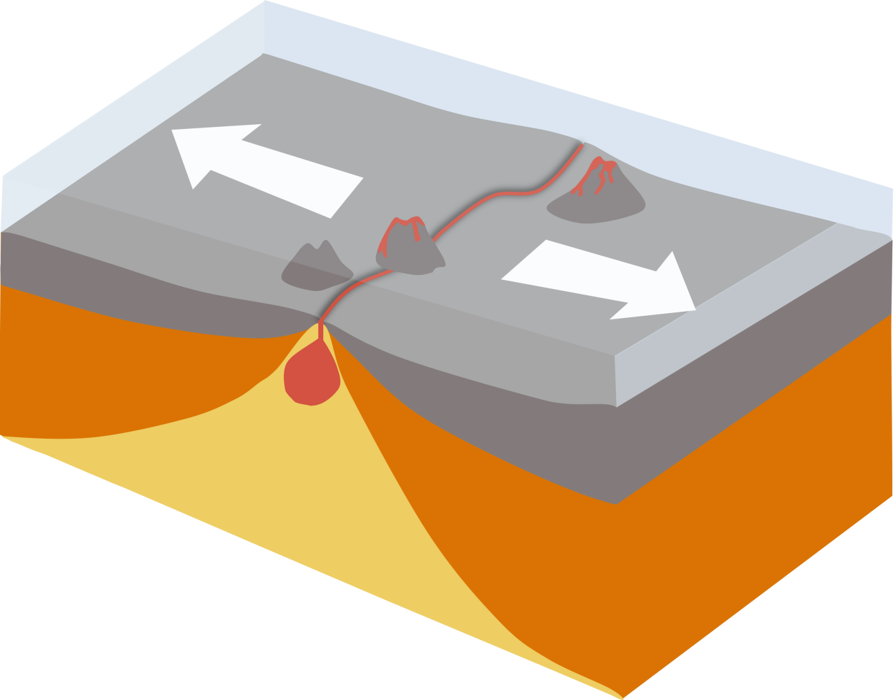
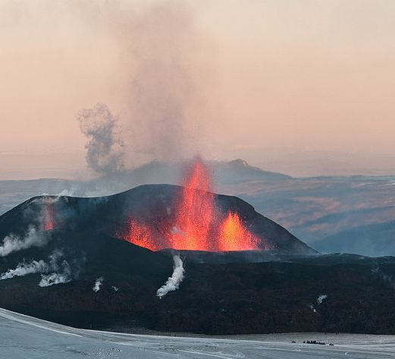
Plates moving AWAY from each other
Volcanoes
New ocean crust
Iceland
Magma
David Karnå / CC by 3.0
Notes:
There are 3 ways in which we can get volcanoes on Earth: places where plates are moving away from each other, places where plates are moving towards each other and places where the mantle is extremely hot.
When two plates are moving away from each other this is called a constructive plate boundary.
When these plates pull apart the mantle below melts and forms pockets of hot liquid magma. This magma, which is lighter than he surrounding rock, rises up to fill in the gap and erupts on the sea floor as underwater volcanoes.
The Mid Atlantic Ridge is an example of a constructive plate boundary on Earth, it is actually a huge chain of under water volcanoes. Iceland which is located on the Mid Atlantic ridge has around 30 active volcanoes an more than 100 extinct volcanoes.

Slide 13

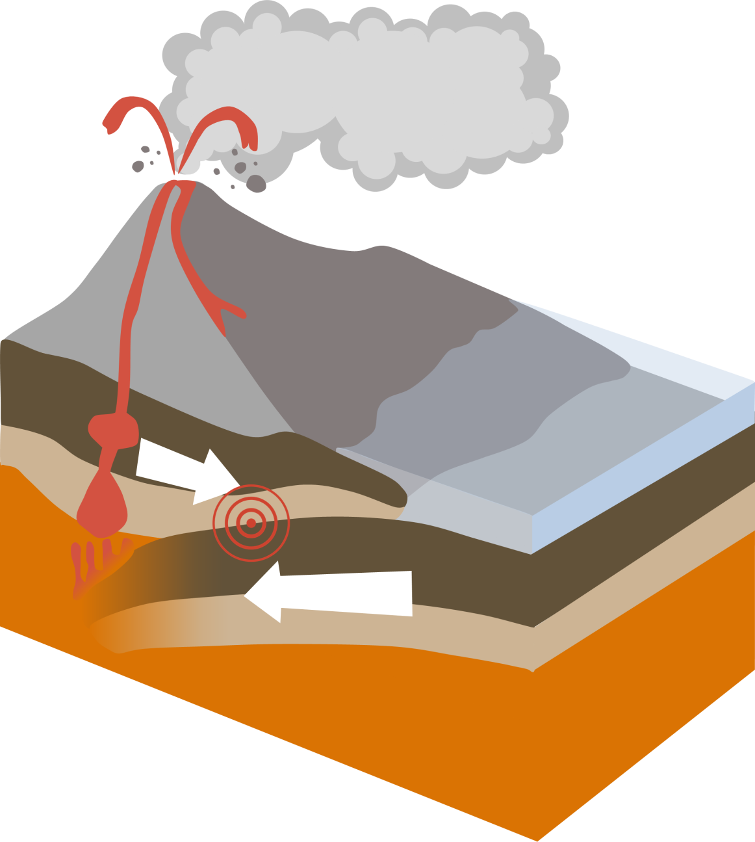
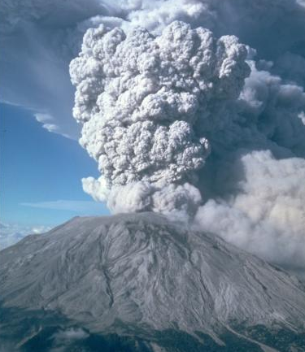
Plates moving TOWARDS each other
Volcano
Magma
Mount St. Helens, Washington, USA
Plate melts
Plate is subducted
Notes:
When an oceanic plate is moving towards a continental plate (or two oceanic plates are moving towards each other) a subduction zone forms. This is a place where the cold, old, oceanic plate is pulled down into the Earth’s mantle where it melts to form magma (molten rock).
This magma then rises and erupts explosively on land as lava and forms volcanoes. The Andes mountain chain in South America is formed from a chain of volcanoes above a subduction zone. As well as having lots of volcanic activity, earthquakes are also very common at subduction zones, generated by the two plates grinding against each other.

Slide 14

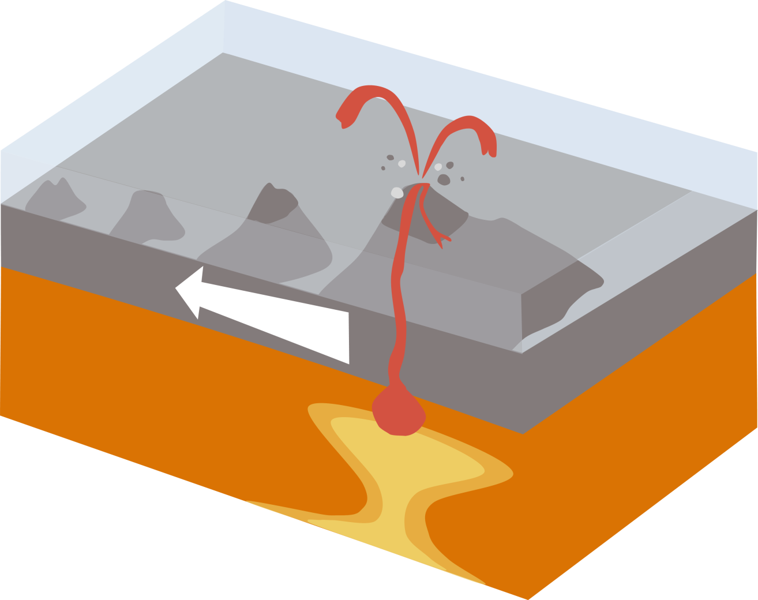
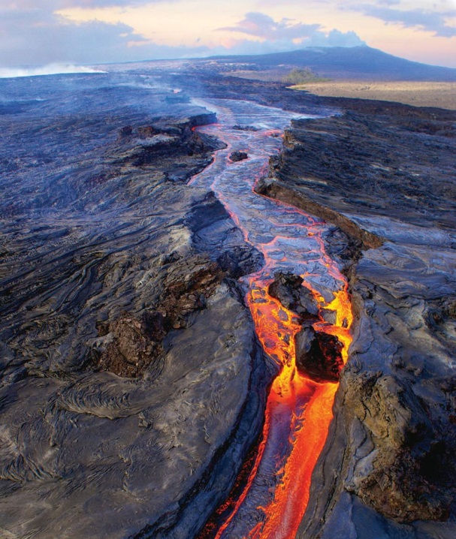
Plate moving OVER a HOTSPOT
Older extinct volcanoes
Active volcano
Plate moving over hotspot
Magma
Hot spot
Kilauea, Hawaii
Notes:
Most volcanic activity occurs at plate boundaries, however sometimes volcanoes can form in the middle of plates far away from any plate boundary.
These volcanoes for example those which make up the Hawaiian islands likely form due to ‘hot spots’, areas of super-heated rocks in the Earth’s mantle, which cause magma to rise and erupt as lava on the ocean floor, creating underwater volcanoes. Eventual when enough lava has erupted these volcanoes breach the surface and become volcanic islands.
Over millions of years, plates move like conveyor belts above the stationary mantle hot spots creating chains of volcanic islands like the Hawaiian Islands in the Pacific ocean.

Slide 15

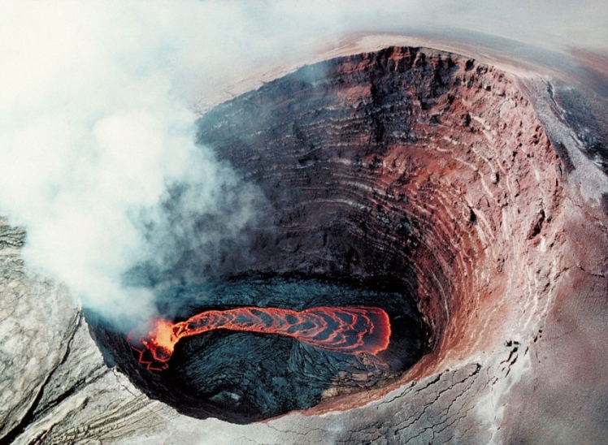
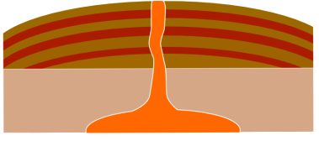
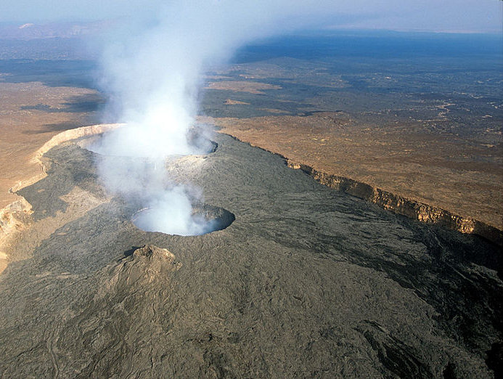
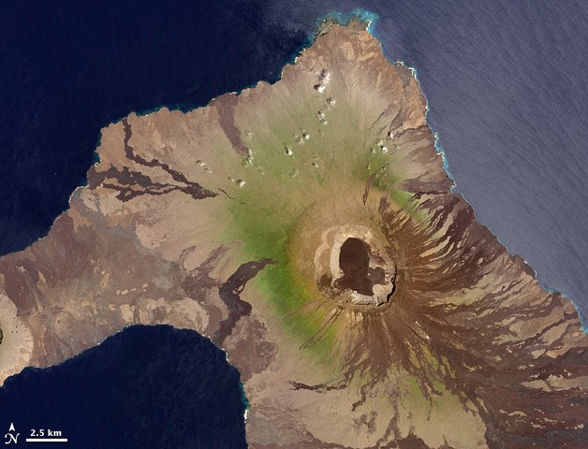
Shallow slopes made from lava
Runny basalt magma
Kilauea lava lake, Hawaii
Wolf Volcano, Galapagos Islands
Erta Ale Volcano, Ethiopia
Photo: filippo_jean/CC-By-2.0
Olympus Mons on Mars
Notes:
Shield volcanoes form from gentle (effusive) eruptions of runny lava. Because it’s so runny, this lava can travel a long way before it solidifies into rock and creates wide, sloping volcanoes in the shape of a shield.
Kilauea and Mauna Loa on the Big Island of Hawaii are good examples of shield volcanoes as well
Mars also has shield volcanoes – including Olympus Mons the biggest volcano in the whole solar system!

Slide 16

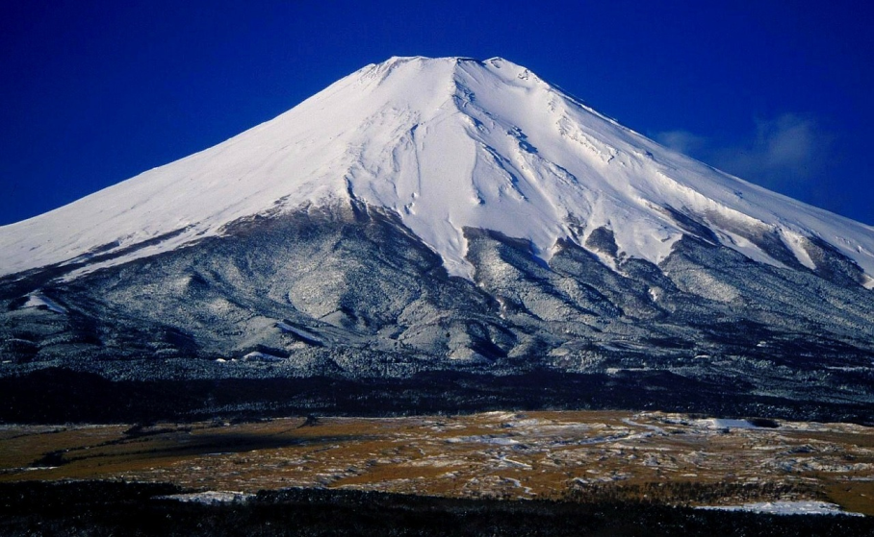
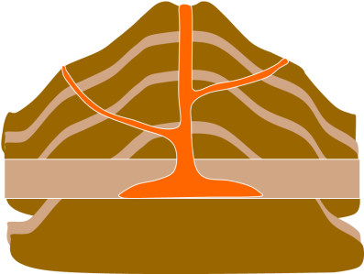
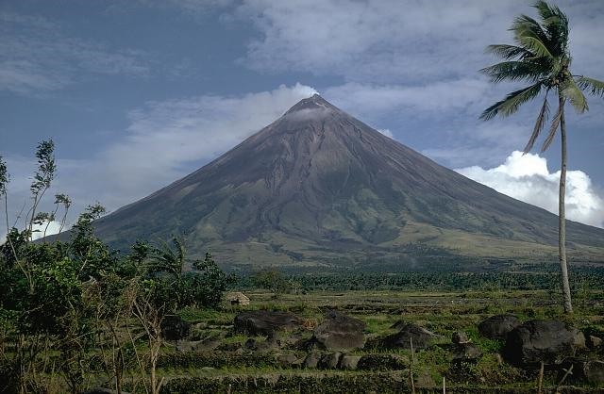
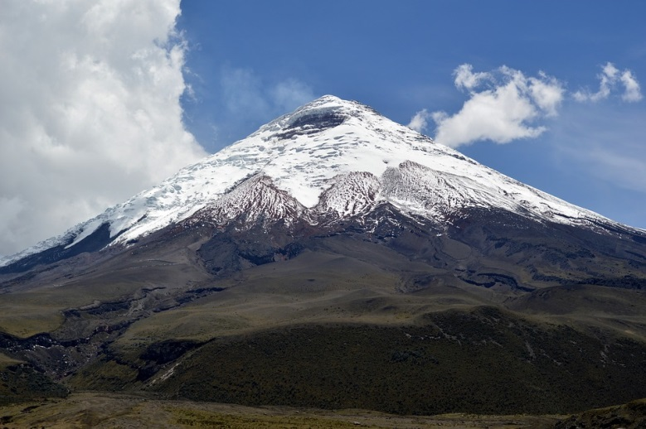
Mount Fuji, Japan
Sticky magma
Steep slopes made from lava and ash
Mount St. Helens, Washington, USA
Cotopaxi, Ecuador
Mayon Volcano, Philippines

Slide 17


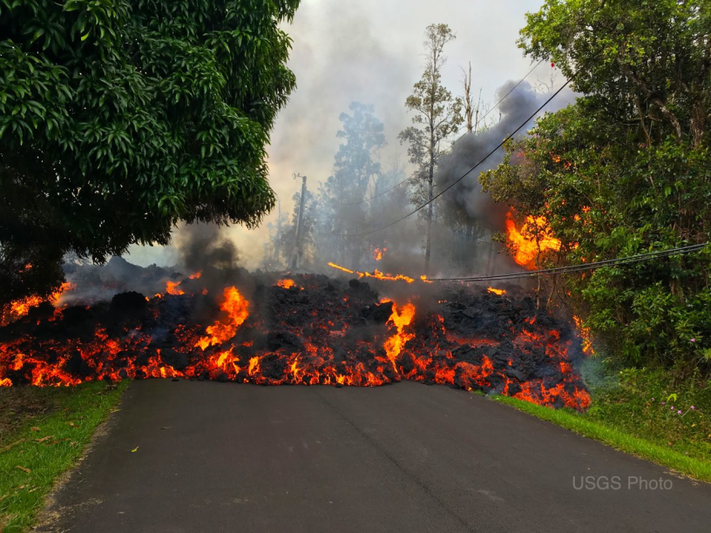
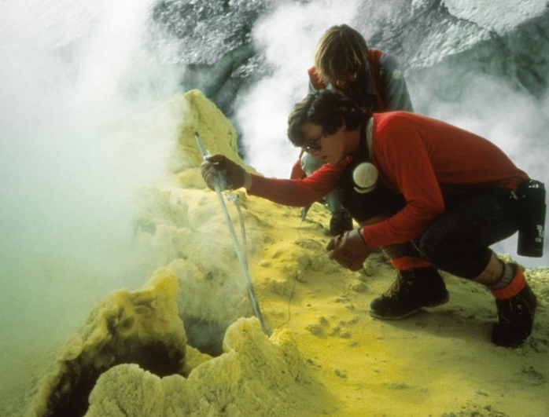
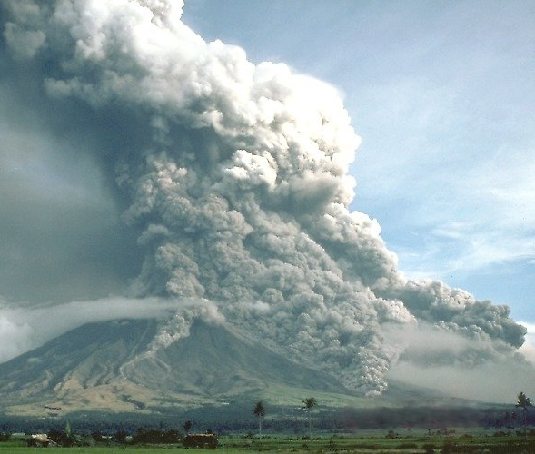
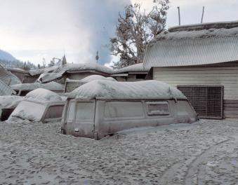
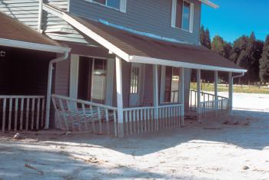
Volcanic gas sampling, Mount Baker, Washington
NATURAL HAZARD: a natural event that might harm people or the environment
Road destroyed by lava flow, Hawaii
Pyroclastic flows
Mount Mayon,
Philippines
House damaged by a lahar, Mount St Helens
Volcanic ash,
Papua New Guinea
Ash erupting from Mount Etna, Italy
Notes:
Volcanic eruptions are a natural hazards. This means that they are natural events that might harm people and the environment.
Q: What might happen to the people who live near a volcano when it erupts?
There are many ways in which volcanoes can be dangerous:
Lava flows are not usually dangerous to people because they move quite slowly which means that people can usually get out of the lava flows path. However lava flows can burn down and cover any buildings that happen to be in their path.
In cold countries such as Iceland volcanoes often have ice caps and glaciers. The heat from erupted lava can melt the snow and ice in these ice caps and cause floods.
Volcanic ash is the most common volcanic hazard. Volcanic ash is made from tiny fragments of rock and glass it can get inside aeroplane engines and clog them up causing the engines to fail, it can also poison water supplies and farmland and cause breathing problems in humans and other animals.
Large ash clouds can block out the sun and can sometimes travel so far that it effects weather all over the Earth, when Mount Pinatubo erupted in 1991 ash lowered the Earth’s temperature by 0.5°C for a whole year!
Pyroclastic flows occur when an ash column from an explosive eruptin collapses and starts to flow down the sides of a volcano. Pyroclastic flows are a mixture of extrmemly hot ash, gas and rock fragments, and can be deadly. They can race down the sides of a volcano at speeds of up to 1000kmph and temperatures more than 400°C instantly boiling and crushing anything in their path including people, animals and plants.
Volcanic gas - magma is molten rock containing dissolved gases, these gases are released to the atmosphere during an eruption. Most of the gas in magma is water vapour which is generally harmless however other gases such as carbon dioxide, fluorine, chlorine and hydrogen sulfide, can be extremely harmful to humans and other animals.
Lake Nyos, is a lake in a volcanic crater in Cameroon, West Africa. The magma beneath the lake contains a lot of carbon dioxide gas which seeps into the lake from below. In 1986 over 100,000 tons of carbon dioxide spilled out of the lake and flowed silently down a valley. The gas spread through three villages where over 1700 people lived and caused them all, and over 3000 cattle, to suffocate from lack of oxygen.
Lahars are a type of mud flow caused when volcanic ash and other volcanic debris mixes with water. Lahars flow like water, have a similar texture to wet concrete, and can be 60-70°C . They may not be as hot as pyroclastic flows however they are extremely destructive. Lahars can bulldoze and bury anything in their path.
Volcanic eruptions can also cause rock falls, landslides, earthquakes and tsunamis so they can be extremely dangerous natural hazards.

Slide 18

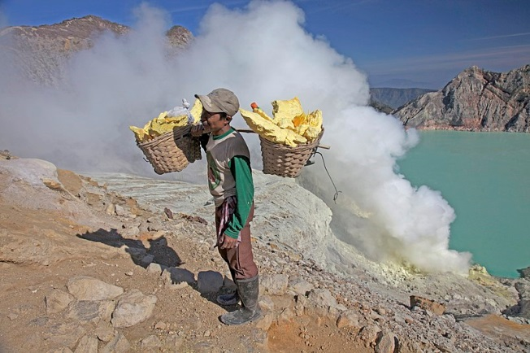
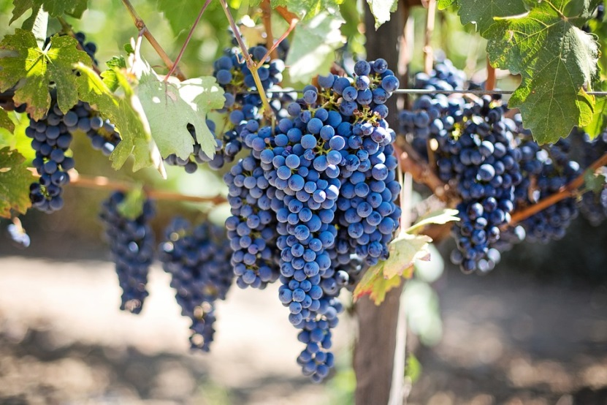
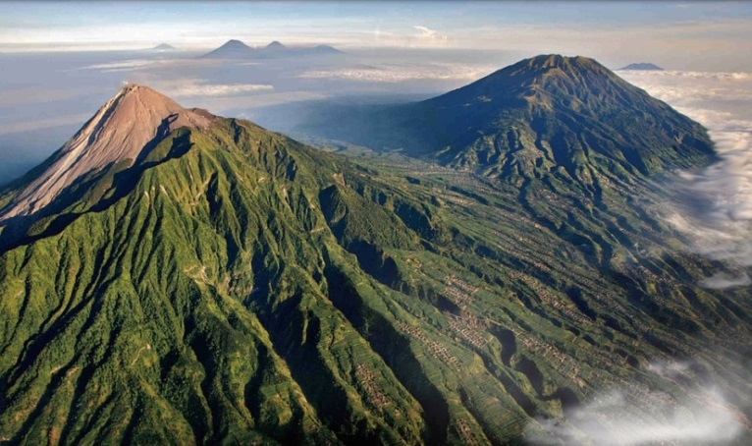
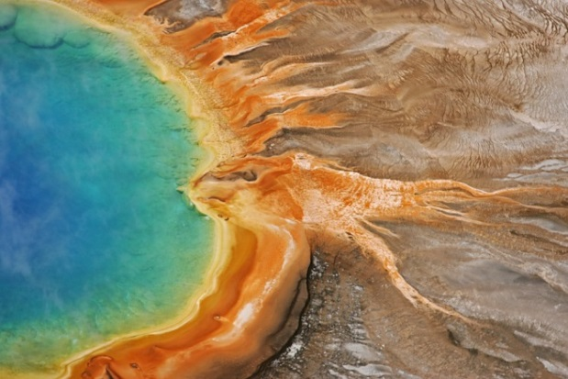
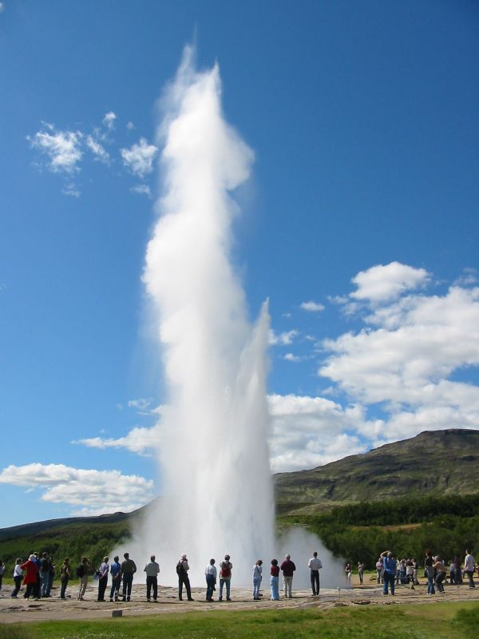

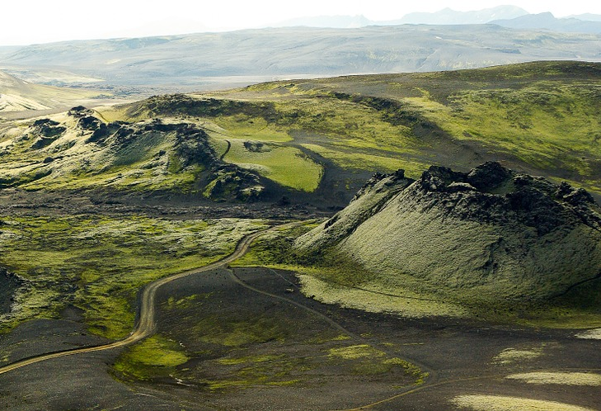

Photo: Scubabeer/CC-By-SA 2.0
Notes:
Hundreds of millions of people around the world choose to live very near and even on the slopes of active volcanoes. Some major cities have even been built close to active volcanoes. Popocatapetl is a volcanic mountain less than 50 miles from Mexico City in Mexico which is home to almost 9 million people.
Q: Why might people choose to live near volcanoes when there are so many risks?
People choose to live near volcanoes because for them the positives outweigh the negatives.
Volcanic ash and lava are rich in minerals so over time they break down to provide valuable nutrients for the soil. This creates very fertile soil which is good for growing fruit and vegetables. The regions around Mount Vesuvius in Italy are particularly well-known for growing grapes, tomatoes and other vegetables in the rich volcanic soils.
Volcanoes create beautiful landscapes. They are important tourist attractions for many countries because they can attract millions of visitors every year. This generates tourism jobs for local people (tourist guides, shops, hotels, restaurants etc.) and brings in money to the country or region.
Volcanic areas be sources of heat energy from the Earth – geothermal energy. The heat from underground steam is a type of renewable energy and can be used to drive turbines and produce electricity, or to heat water supplies that are then used to provide household heating and hot water. In Iceland 85% buildings are heated by geothermal energy and 25% of the nations electricity is generated from geothermal energy.
Important minerals such as zinc, lead, tin, copper, silver and gold can be found in volcanic rocks. Hot gasses escaping through vents of active volcanoes also bring minerals to the surface, particularly the mineral sulfur which is a chalky yellow colour and often smells of eggs! Mount Ijen in Indonesia is known having a lot of sulfur, so much so that the volcano actually glows blue at night (sulfur is yellow in colour but when it burns, which it does when it meets the oxygen in the air, it does so with a blue flame). Locals collect the sulfur at the volcano crater and carry it down the mountain where they sell it for around 8 US cents per kilogram.
People might not be able to afford to leave their homes to move to somewhere with less risk of eruptions. Even when people can afford to leave the area they may be attached to their homes and not want to leave as their families have lived there for generations.

Slide 19





Fumaroles, Sicily
Benjamín Núñez González/ CC-BY- S.A 4.0
Seismometer for detecting earthquakes
Tiltmeter on Mauna Loa, Hawaii
GPS receiver at Newberry volcano, Oregon, USA
Photo: USGS
Notes:
Because volcanoes can harm people, animals and the environment when they erupt, it is important for geologists to monitor volcanoes around the world so that they can work out if an eruption might occur. Monitoring a volcano requires geologists to use of a variety of techniques that can hear and see activity inside a volcano so they can detect when a volcano might be reawakening.
Gases –geologists can monitor volcanoes to see whether they might be close to erupting by looking at the volcanic gases that come out. As magma rises toward the surface gases separate from the liquid because the pressure is lower. Because gas is less dense than magma, it rises quickly and can be detected at the surface of the Earth and comes out through vents called fumaroles. An increase in the amount of gas given off, the appearance of new gas vents, or a change in the chemical makeup of the gas can be some of the first aboveground signs of increased volcanic activity.
Ground surface changes - magma, gas, and other fluids moving underground before a volcanic eruption can cause changes in a volcano's ground surface. These changes can be swelling, sinking, or cracking. Often, this surface change is very small – a few centimeters or less so geologists must use very sensitive instruments to monitor these changes.
One type of instrument that detects land surface changes is called a tiltmeter. Tiltmeters continuously measure the tilt of the ground surface – if magma is collecting beneath a volcano it will usually cause the surface above to inflate and tiltmeters can measure these changes.
Another way land surface changes are monitored is to use satellite data. To do this, multiple receivers are placed around a volcano, satellites travelling around the Earth can then detect whether any of these receivers have moved over time which might indicate that the volcano is bulging with magma and ready to erupt.
Earthquakes - as magma and volcanic gases rise to the surface from depth they can cause earthquakes. Most volcano related earthquakes are too small to feel by humans so geologists monitor the earthquakes with instruments called seismometers, which detect the amount of shaking form an earthquake, to work out their location, how strong they are and how often they are occurring to determine whether or not an eruption may occur.

Slide 20

What are the arrows on the diagram pointing towards?
Magma chamber and geyser
Magma chamber and conduit
Ash cloud and conduit
Notes:
B: Magma chamber and conduit

Slide 21
What is a dormant volcano?
One that is erupting lava
One that hasn’t erupted recently (in the last 10,000 years)
One that is erupting ash
Notes:
B: One that hasn’t erupted recently (in the last 10,000 years)

Slide 22

Where can volcanoes occur? (2 answers)
Above hotspots in the mantle
At destructive plate boundaries
At conservative plate boundaries
Notes:
A + B: Above hotspots in the mantle, At destructive plate boundaries

Slide 23
What type of eruption is happening here?
Effusive eruption
Explosive eruption
Shield eruption
Notes:
B: Explosive eruption

Slide 24

What is this geologist sampling?
Magma
´A´a lava
Pahoehoe lava
Notes:
C: Pahoehoe lava

Slide 25

Which of these is a composite volcano?
Shallow slopes, shield shaped
Steep slopes, cone shaped
Crack in the ground
Notes:
B: Steep slopes, cone shaped

Slide 26

What sometimes forms inside a volcano crater?
Hotspot
Magma Chamber
Lava lake
Notes:
C: Lava lake

Slide 27

Which of these are not natural hazards that can be caused by volcanoes?
Lahars
Pyroclastic flows
Hurricanes
Notes:
C: Hurricanes

Slide 28
Which of these is NOT a positive reason for living near a volcano?
Volcanic ash can disrupt air travel
Volcanoes can attract tourists to areas, which creates jobs
Volcanic ash and lava break down over time to provide nutrients for the soil
Notes:
cccc

Slide 29

What instrument is used to monitor ground surface changes?
Seismometer
Tiltmeter
Microscope
Notes:
B: Tiltmeter

